Slide 1
Accuracy and Precision
A digit that must be estimated is called uncertain.
A measurement always has some degree of uncertainty.

Slide 2
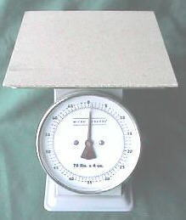
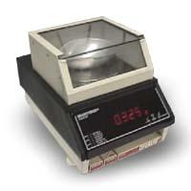
Why Is there Uncertainty?
Measurements are performed with instruments
No instrument can read to an infinite number of decimal places
Which of these balances has the greatest uncertainty in measurement?

Slide 3
When measuring (and only in measurement)
Scientists record their measurements by recording the numbers that are absolutely known, plus one place setting as a guess.

Slide 4
Precision
Precision is how close the measured values are to each other.

Slide 5
Accuracy
Accuracy is how close a measured value is to the actual (true) value.

Slide 6
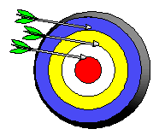
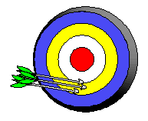
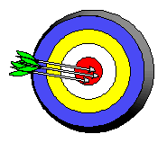
Precision and Accuracy
Neither accurate nor precise
Precise but not accurate
Precise AND accurate

Slide 7
Precision and Accuracy
The mass of 5 pennies were measured on a triple beam balance. Here are the reported measurements.
13.85 g
13.8 g
12.06 g
14 g
Precise?

Slide 8
Precision and Accuracy
The volume of water displaced by a solid were reported as follows:
20.5 mL
20.5 mL
20.3 mL
20.6 mL
Precise?

Slide 9
Precision and Accuracy
The Length of my room is 10.371 m. My students recorded the measurements below:
11.0250 m
10.371 m
10.810 m
10.876 m
Accurate? Precise? Or both

Slide 10
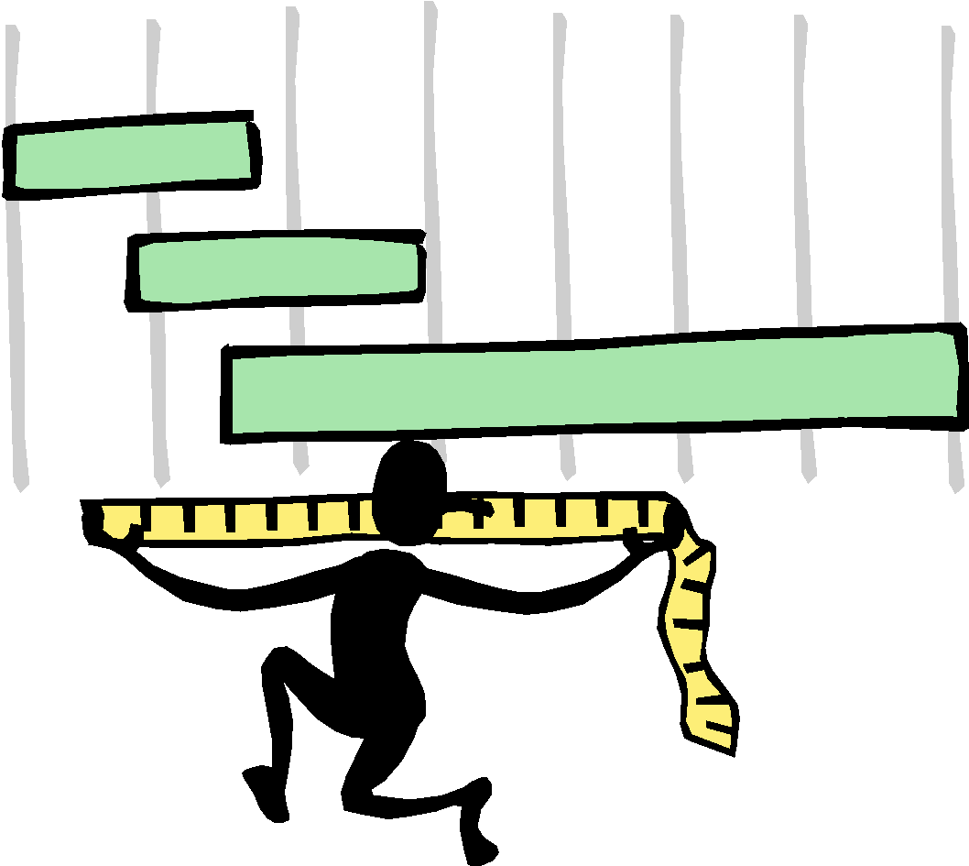
Metric Conversions Ladder Method
T. Trimpe 2008 http://sciencespot.net/

Slide 11
Ladder Method
1
2
KILO 1000 Units
3
HECTO 100 Units
DEKA 10 Units
DECI 0.1 Unit
CENTI 0.01 Unit
MILLI 0.001 Unit
Meters Liters Grams
How do you use the “ladder” method?
4 km = _________ m
1st – Determine your starting point.
2nd – Count the “jumps” to your ending point.
3rd – Move the decimal the same number of jumps in the same direction.
Starting Point
Ending Point
How many jumps does it take?
4.
__.
__.
__.
= 4000 m
1
2
3

Slide 12
Conversion Practice
Try these conversions using the ladder method.
1000 mg = _______ g 1 L = _______ mL 160 cm = _______ mm
14 km = _______ m 109 g = _______ kg 250 m = _______ km
Compare using <, >, or =.
56 cm 6 m 7 g 698 mg

Slide 13
Metric Conversion Challenge
Write the correct abbreviation for each metric unit.
1) Kilogram _____ 4) Milliliter _____ 7) Kilometer _____
2) Meter _____ 5) Millimeter _____ 8) Centimeter _____
3) Gram _____ 6) Liter _____ 9) Milligram _____
Try these conversions, using the ladder method.
10) 2000 mg = _______ g 15) 5 L = _______ mL 20) 16 cm = _______ mm
11) 104 km = _______ m 16) 198 g = _______ kg 21) 2500 m = _______ km
12) 480 cm = _____ m 17) 75 mL = _____ L 22) 65 g = _____ mg
13) 5.6 kg = _____ g 18) 50 cm = _____ m 23) 6.3 cm = _____ mm
14) 8 mm = _____ cm 19) 5.6 m = _____ cm 24) 120 mg = _____ g

Slide 14
Compare using <, >, or =.
25) 63 cm 6 m 27) 5 g 508 mg 29) 1,500 mL 1.5 L
26) 536 cm 53.6 dm 28) 43 mg 5 g 30) 3.6 m 36 cm

Slide 15
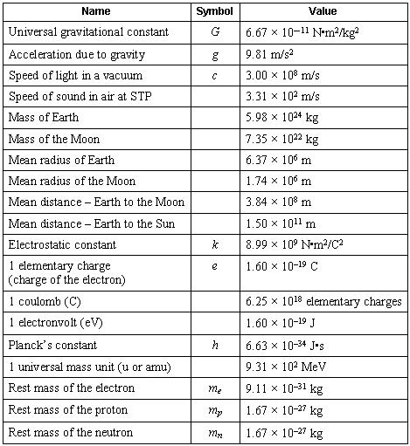
Scientific Notation

Slide 16
Scientific Notation
In science, we deal with some very LARGE numbers:
1 mole = 602000000000000000000000
In science, we deal with some very SMALL numbers:
Mass of an electron =
0.000000000000000000000000000000091 kg

Slide 17
Imagine the difficulty of calculating the mass of 1 mole of electrons!
0.000000000000000000000000000000091 kg
x 602000000000000000000000
???????????????????????????????????

Slide 18
Scientific Notation:
A method of representing very large or very small numbers in the form:
M x 10^{n}
M is a number from 1 to 9.9
n is an integer (can be positive or negative) The exponent is the number of places we move the decimal.

Slide 19
.
2 500 000 000
9
8
7
6
5
4
3
2
1
Step #1: Insert an understood decimal point
Step #2: Decide where the decimal must end
up so that one non-zero number is
to its left
Step #3: Count how many places you moved
the decimal point
Step #4: Re-write in the form M x 10^{n}
2.5 x 10⁹

Slide 20
0.0000579
1
2
3
4
5
Step #2: Decide where the decimal must end
up so that one non-zero number is
to its left
Step #3: Count how many places you moved
the decimal point
Step #4: Re-write in the form M x 10^{n}
The exponent is negative because the number we started with was less than 1.
5.79 x 10⁻⁵

Slide 21
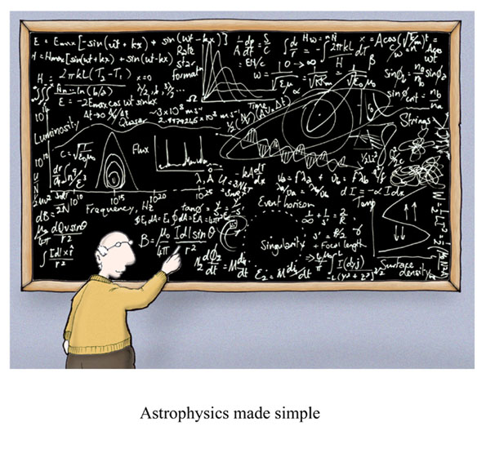
Significant Figures
Cartoon courtesy of Lab-initio.com

Slide 22
Rules for Counting Significant Figures - Details
Nonzero integers always count as significant figures.
3456 has
4 significant figures

Slide 23
Rules for Counting Significant Figures - Details
Zeros
- Captive zeros always count as
significant figures.
16.07 has
4 significant figures

Slide 24
Rules for Counting Significant Figures - Details
Zeros
Trailing zeros are significant only if the number contains a decimal point.
9.300 has
4 significant figures
9300 only has 2 significant figures

Slide 25
Rules for Counting Significant Figures - Details
Zeros
- Leading zeros do not count as
significant figures.
0.0486 has
3 significant figures

Slide 26
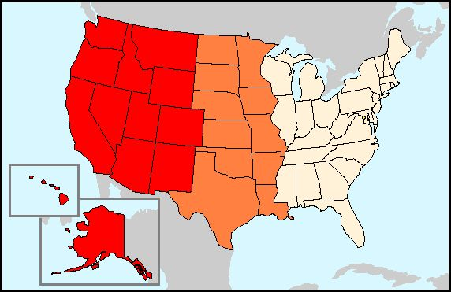
SIGNIFICANT FIGURES
United States Method
Pacific Ocean
=
Point Present
Atlantic Ocean =
Point Absent

Slide 27
Sig Fig Practice #1
How many significant figures in each of the following?
1.0070 m →
5 sig figs
17.10 kg →
4 sig figs
100,890 L →
5 sig figs
3.29 x 10³ s →
3 sig figs
0.0054 cm →
2 sig figs
3,200,000 →
2 sig figs

Slide 28
Sig Figs with math
Addition and Subtraction
Count the number of decimal places to determine the number of significant figures. The answer cannot contain more places after the decimal than the smallest number of decimal places in the numbers being added or subtracted.
23.112233 50.21
1.3324 4.635
+ 1.25 -0.5
25.694633 calculator answer 45.075
25.69 your answer 45.1

Slide 29
Sig Figs with Math
Multiplying and Dividing
When multiplying or dividing numbers, count the number of significant figures. The answer cannot contain more significant figures than the number being multiplied or divided with the least number of significant figures.
23.112233
1.3324 50.21
x 1.25 ÷ 4.6357
38.49342406 calculator answer 10.83115819
38.5 your answer 10.83

